Slide 1

Fondamenti di robotica – final project
Luca Boschiero – mat. 217460
Usama Aarif – mat. 217696
Mauro Meneghello – mat.217564

Slide 2
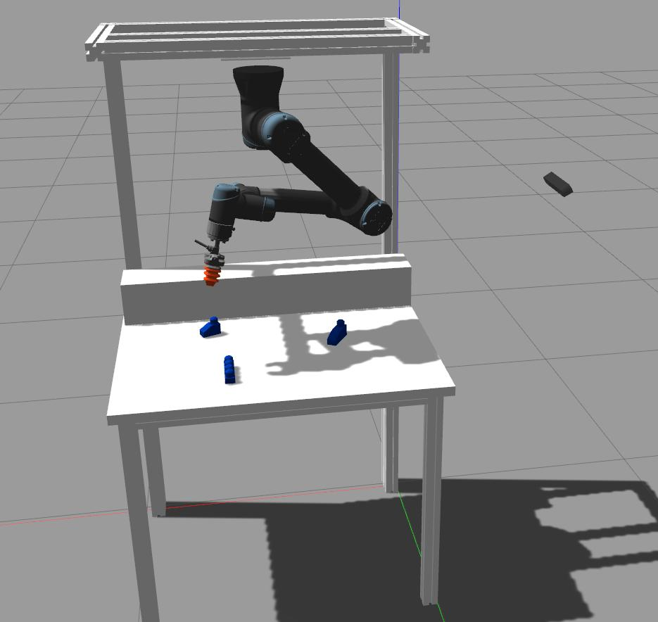
Goal
Detect some lego blocks placed on the table with a zed camera.
Pick the blocks up and move them to a final position.

Slide 3
Workflow
Kinematics
Motion
Vision

Slide 4
Kinematics
Joint configuration
End-effector pose
Direct kinematics
Inverse kinematics
Differential inverse kinematics

Slide 5
Motion plan
1. Moves the robot from the initial homing position towards the first detected block.
2. Lowers the arm to the block to grasp it, with the gripper opened.
3. Closes the gripper and grasps the block.
4. Raises the arm with the grasped block.
5. Moves the robot to the final position, that depends on the class of the block.
6. Puts the block down to the final stand and leaves the block by opening the gripper.
7. Moves back to the homing position and, if other blocks are detected on the table repeat the motion plan, otherwise stops its execution.

Slide 6
Vision
Uses yolov5_ros to detect the position and global registration for the orientation of the blocks
Gets the points of the block in the pointcloud and transform the .stl model in a Open3d pointcloud
Acquires the FPFH features of the pointclouds and use them to align the two pointclouds using Open3d RANSAC registration
In the end the Open3d ICP registration is performed to optimize the registration and to get the rotation matrix

Slide 7

Task 1

Slide 8
Task 2

Slide 9
Task 2

Slide 10
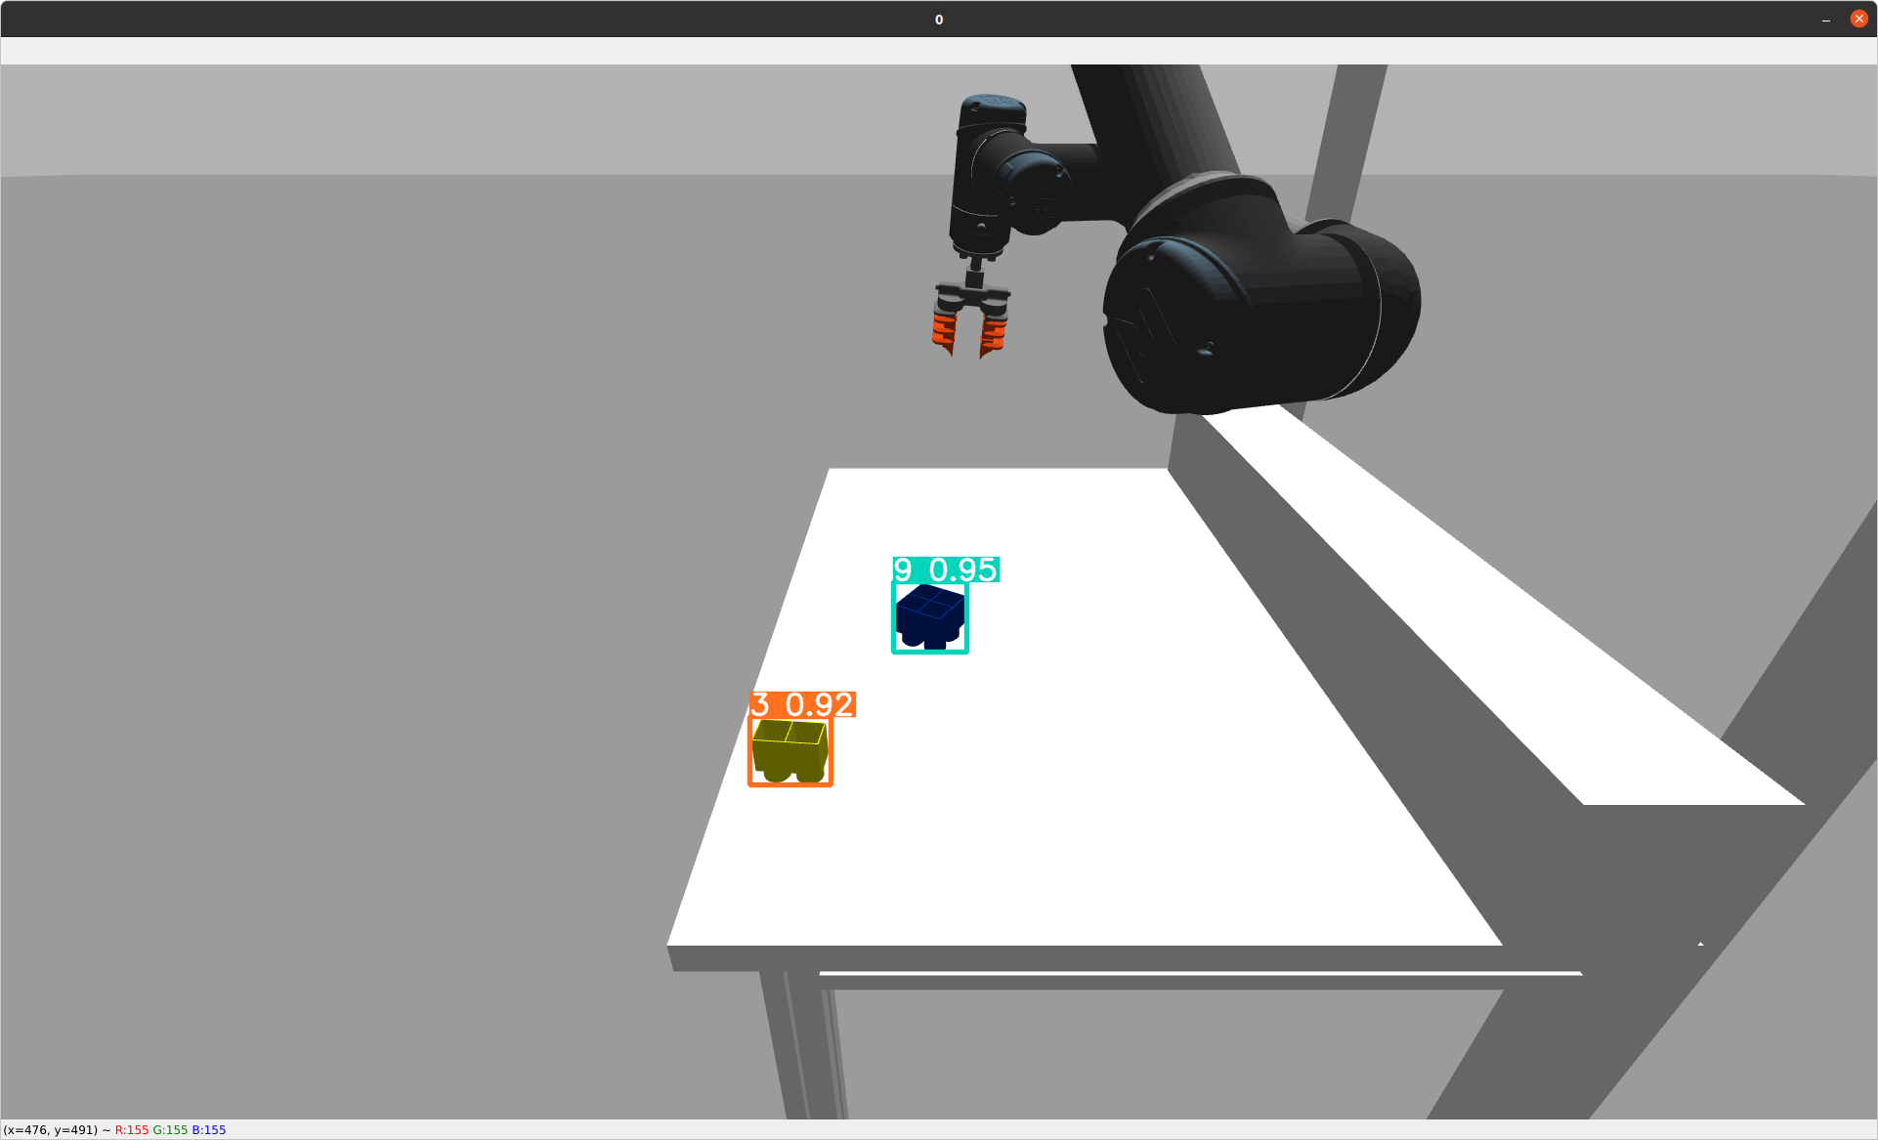
Task 3 (detection)

Slide 11
Performance indicators
 | KP1 | KP2
Task 1 | 1 - 2 s | 20 - 25 s
Task 2 | 60 s (3 blocks) | /
Task 3 | Only detection | /
Task 4 |  | /

Slide 12
Credits and GitHub repository
Luca Boschiero – mat. 217460
Usama Aarif – mat. 217696
Mauro Meneghello – mat.217564
GitHub repository: https://github.com/lucaboschiero/robotica
(follow the instruction on the Readme to mount it)

